Slide 1
A Dip into ‘A Course in Theoretical Physics’ by P.J. Shepard
C. Schiff
Last updated – 12/12/2016

Slide 2
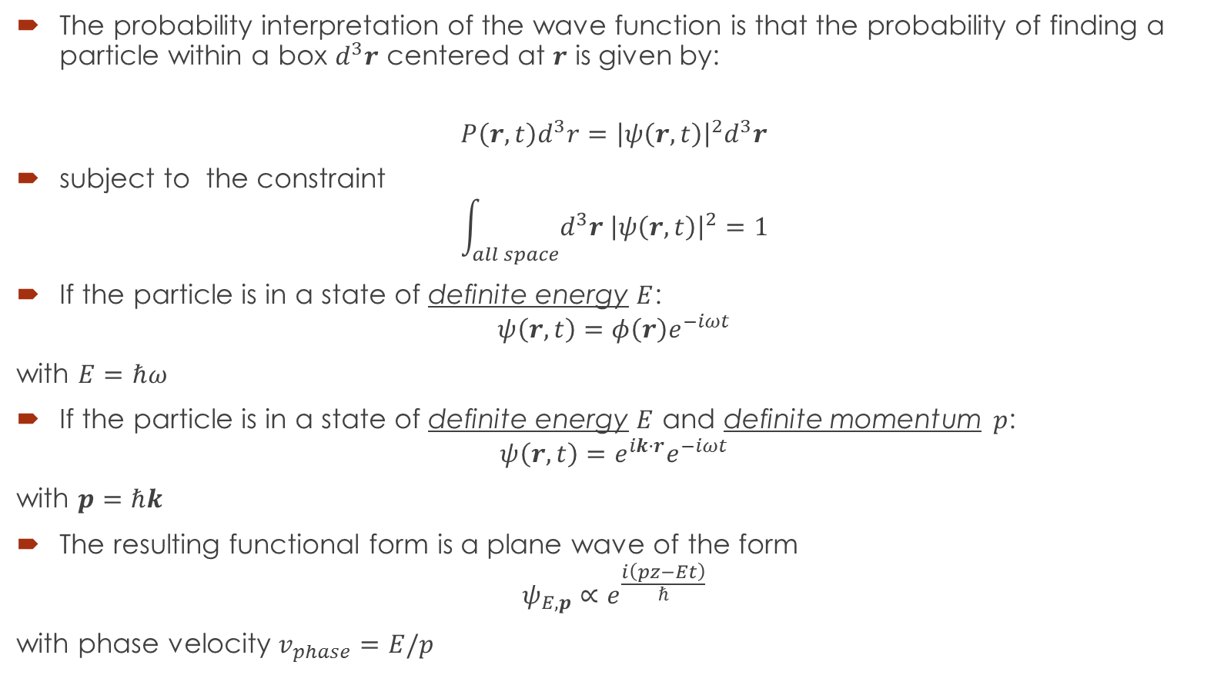
Chapter 1 (1/ch1)
The probability interpretation of the wave function is that the probability of finding a particle within a box $d^{3}r$ centered at $r$ is given by:
$$P\left(r,t\right)d^{3}r={\left|ψ\left(r,t\right)\right|}^{2}d^{3}r$$
subject to the constraint
$$\int_{all space}{d^{3}r {\left|ψ\left(r,t\right)\right|}^{2}}=1$$
If the particle is in a state of definite energy $E$:
$$ψ\left(r,t\right)=φ\left(r\right)e^{−iωt}$$
with $E=ℏω$
If the particle is in a state of definite energy $E$ and definite momentum $p$:
$$ψ\left(r,t\right)=e^{ik⋅r}e^{−iωt}$$
with $p=ℏk$
The resulting functional form is a plane wave of the form
$$ψ_{E,p}∝e^{\frac{i\left(pz−Et\right)}{ℏ}}$$
with phase velocity $v_{phase}=E/p$

Slide 3

Chapter 1 (2/ch1)
All observables ($≡$physically measurable quantities) are mapped to operators
To determine the energy apply $\hat{E}=iℏ\frac{∂}{∂t}$
To determine the momentum apply $\hat{p}=−iℏ∇$

